Slide 1
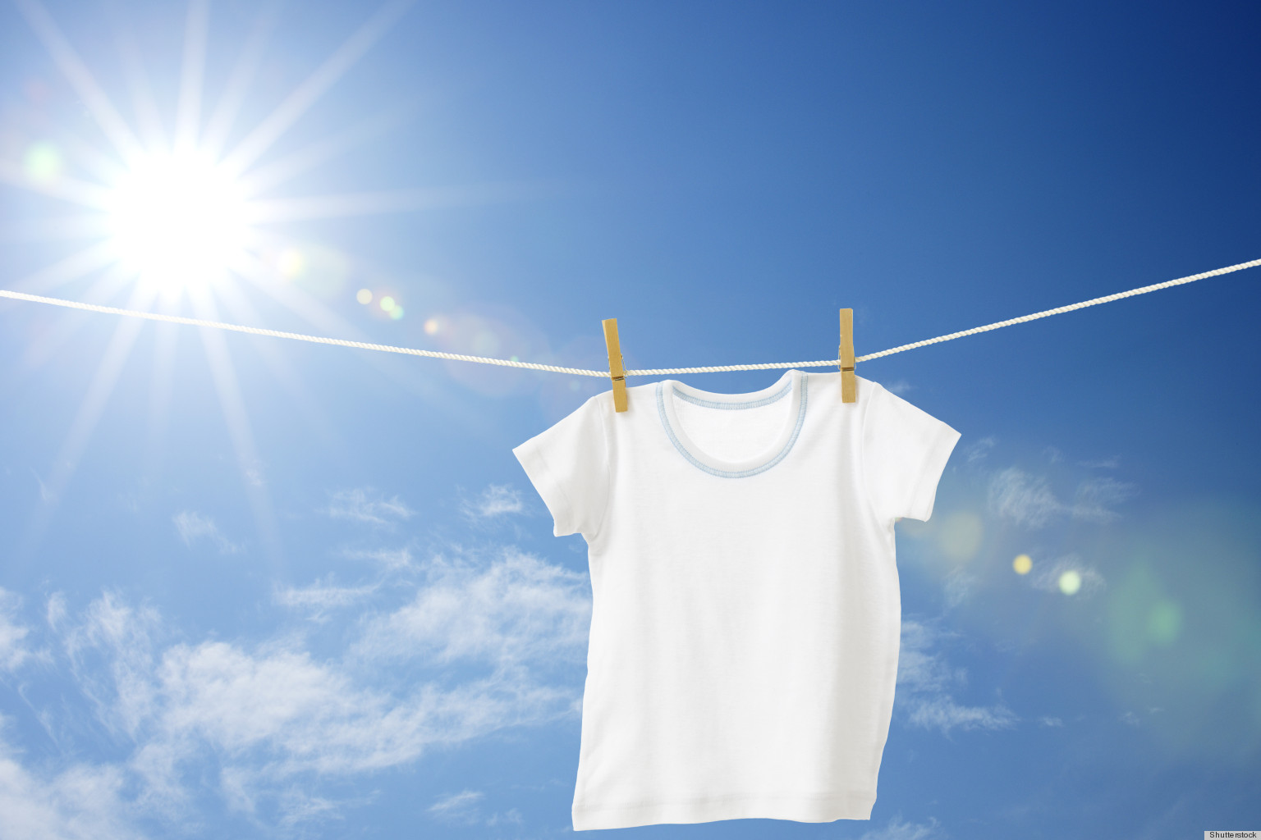
Dressed To Meet Christ:
Proper Attire For The New Self

Slide 2
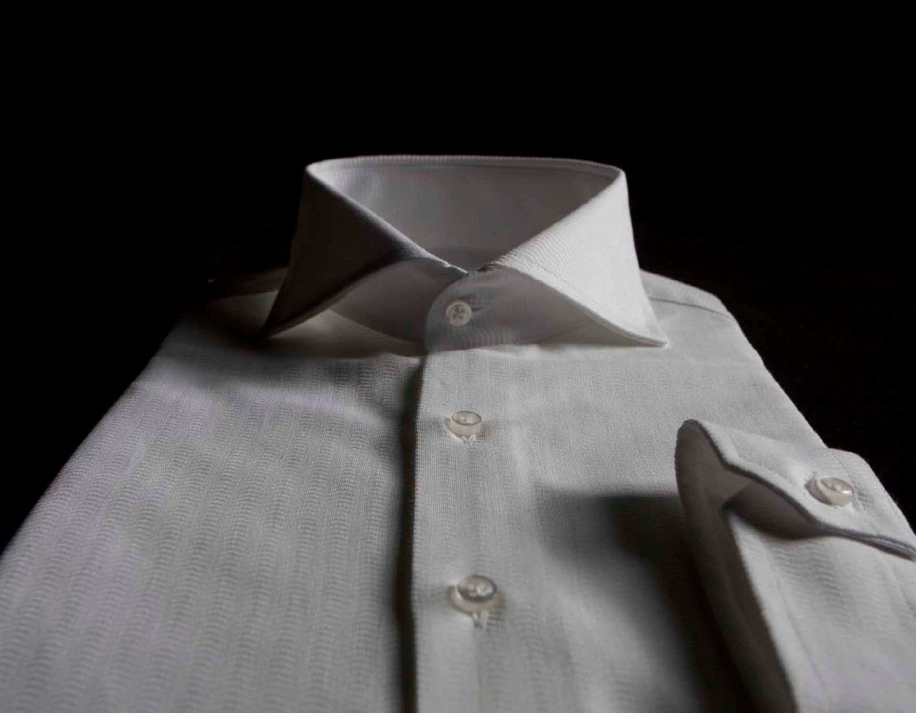
Clothes Of The New Self

Slide 3
Clothes Of The New Self
Compassionate Hearts
  Sensitivity to the needs of others
  Actively looking for situation in need of compassion
And a leper came to him, imploring him, and kneeling said to him, “If you will, you can make me clean.” Moved with pity, he stretched out his hand and touched him and said to him, “I will; be clean.” And immediately the leprosy left him, and he was made clean – Mark 1:40-42.

Slide 4
Clothes Of The New Self
Compassionate Hearts
  Sensitivity to the needs of others
  Actively looking for situation in need of compassion
  Members of this congregation need compassion
    Often make excuses:
      “I don’t want to pry”
      “Its none of my business”
      “We all have problems”
      “I’ve got too many responsibilities”
Does This Sound Like Jesus?

Slide 5
Clothes Of The New Self
Kindness
  Goodness of heart with a gentle, gracious disposition
  Shown to everyone
  Real test is with the ungenerous/vindictive

Slide 6
When Israel was a child, I loved him and out of Egypt I called my son. The more they were called, the more they went away; they kept sacrificing to the Baals and burning offerings to idols. Yet it was I who taught Ephraim to walk; I took them up by their arms, but they did not know that I healed them. I led them with cords of kindness, with the bands of love, and I became to them as one who eases the yoke on their jaws, and I bent down to them and fed them. – Hosea 11:1-4

Slide 7
Clothes Of The New Self
Kindness
  Stark difference with “dirty clothes” (verse 8)
  Not a natural disposition – it is learned in Christ

Slide 8
Clothes Of The New Self
Humility
  Christ-like attitude toward self
  Recognizing one’s “littleness”
Then Saul said to David, “Here is my elder daughter Merab. I will give her to you for a wife. Only be valiant for me and fight the Lord's battles.” For Saul thought, “Let not my hand be against him, but let the hand of the Philistines be against him.” And David said to Saul, “Who am I, and who are my relatives, my father's clan in Israel, that I should be son-in-law to the king?” – I Samuel 18:17-18

Slide 9
Clothes Of The New Self
Humility
  Christ-like attitude toward self
  Recognizing one’s “littleness”
  Recognizes God will take care of vindication
Beloved, never avenge yourselves, but leave it to the wrath of God, for it is written, “Vengeance is mine, I will repay, says the Lord.” To the contrary, “if your enemy is hungry, feed him; if he is thirsty, give him something to drink; for by so doing you will heap burning coals on his head.” Do not be overcome by evil, but overcome evil with good. – Romans 12:19-21

Slide 10
Clothes Of The New Self
Meekness
  Gentleness exercised on others due to humility
Moses
Now the man Moses was very meek, more than all people who were on the face of the earth.
Christ
Take my yoke upon you, and learn from me, for I am gentle and lowly in heart, and you will find rest for your souls.
“The temper or spirit in which we accept God’s dealings with us as good and therefore without disputing or resisting.” W.E. Vine

Slide 11
Clothes Of The New Self
Patience
  Cumulative effect of all these qualities in our lives
  No good to say “I wish I was more patient”
    Will not happen without “a change of wardrobe!”
  Serves to help deal with resentment/anger

Slide 12
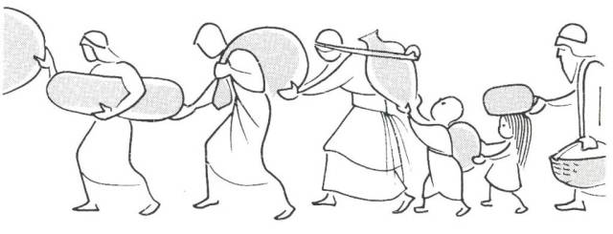
Proof of Change
We Bear With One Another
  We do not hesitate to help another
  We tolerate one another’s “quirks”
We Forgive One Another
  No room left for an unforgiving spirit
  We wear the clothing of Christ!

Slide 13
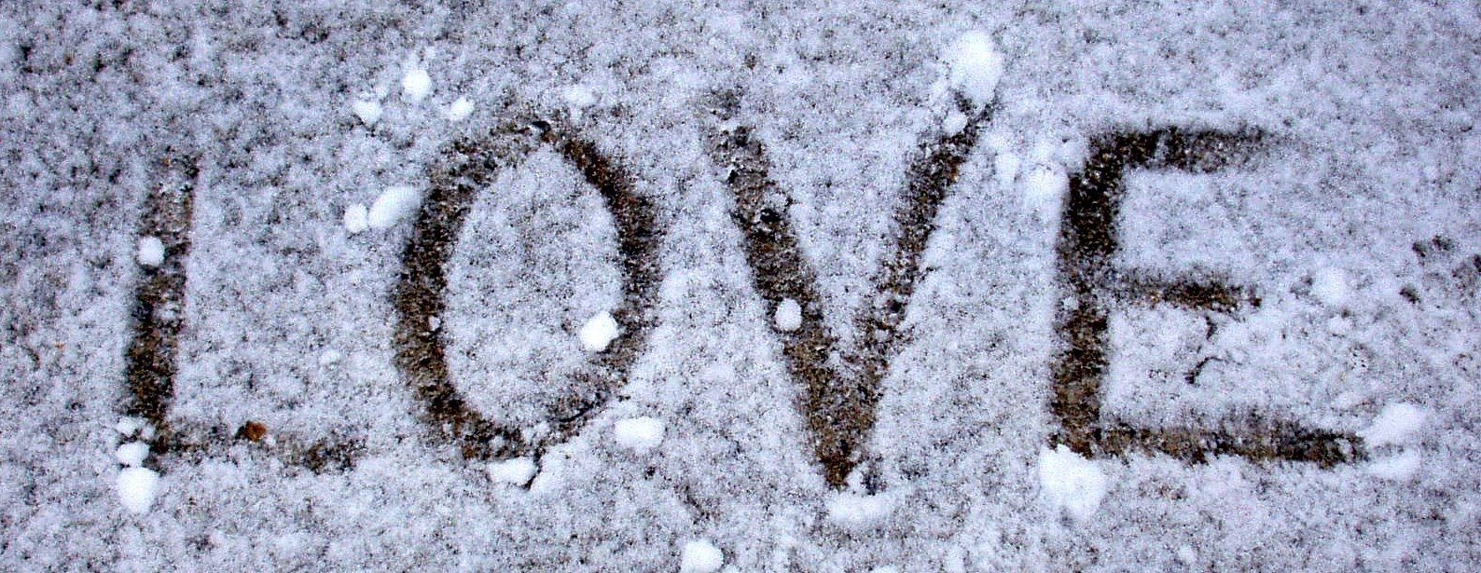
Bound Together By Love
Love that desires the best for another
Love that mimics that of God Himself

